Slide 1



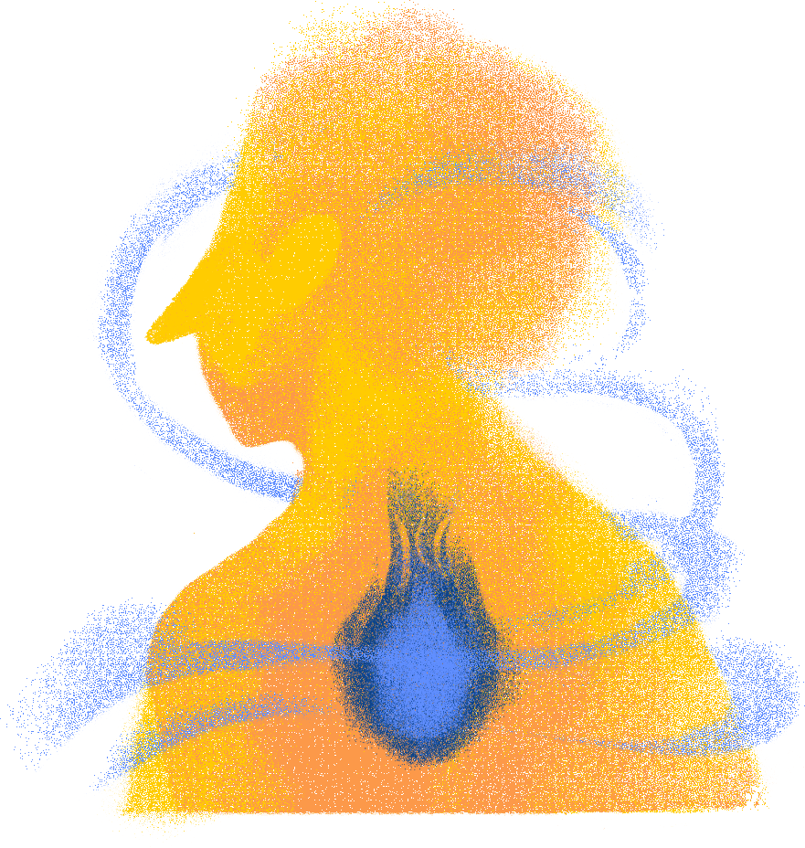
Group 5 LA06
Generalized Least Squares Analysis of Stress Level Based on Sleep Quality, Mental Wellness, and Productivity
  Bella Nadya Aurelia (2702371565)
  Leora Natania Klarise Purba (2702217195)
  Sanly (2702271474)
  Zahra Annisa (2702284086)

Slide 2
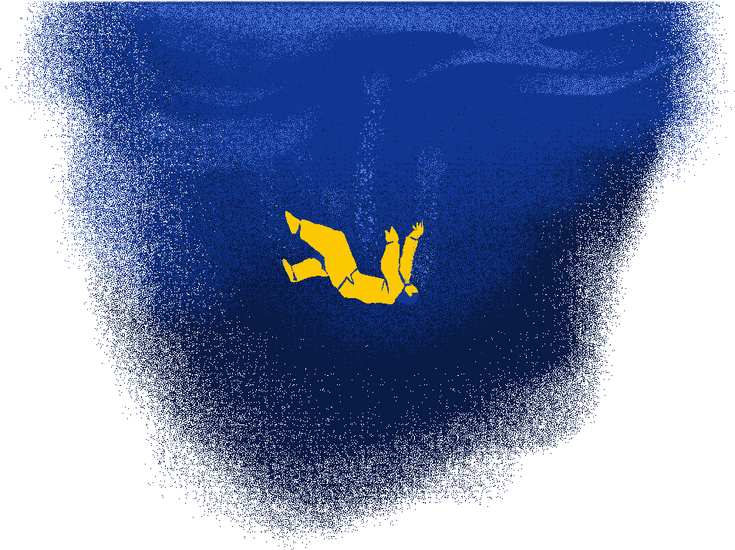
Group 5 LA06
Introduction
Work stress has become a major issue in today’s high-pressure work environment, affecting both physical and mental well-being as well as job performance. In 2023, the Health and Safety Executive reported 875,000 cases of work-related stress, depression, and anxiety, highlighting stress as a significant public health concern.
Work stress is commonly driven by excessive workload, time pressure, and interpersonal conflicts, particularly among employed and self-employed workers. High stress levels are strongly associated with poor sleep quality, declining mental well-being, and reduced productivity. Previous studies across various professions, including nurses and lecturers, consistently show that increased work stress disrupts sleep and lowers overall psychological health, which in turn negatively impacts productivity.
Although many studies have examined the relationship between stress, sleep quality, mental well-being, and productivity, most rely on Ordinary Least Squares (OLS) regression, which assumes homoscedasticity. However, behavioural data often violate this assumption. This study addresses this methodological gap by applying Generalized Least Squares (GLS) to jointly analyze sleep quality, mental well-being, and productivity as predictors of work stress, providing more reliable estimates under heteroscedastic conditions.

Slide 3
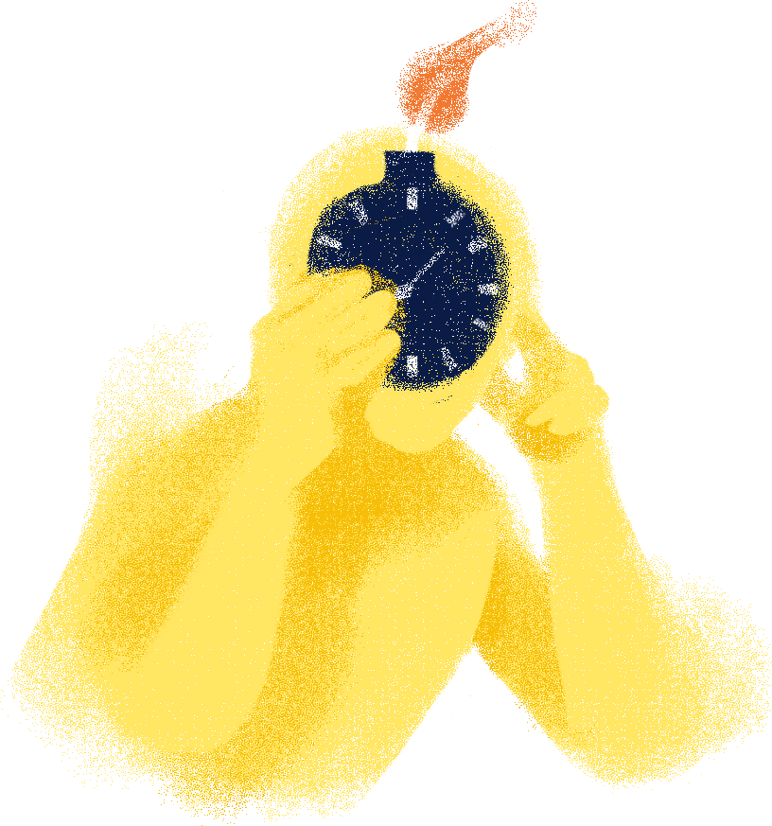
Group 5 LA06
Research Questions
  Does sleep quality, productivity, and mental wellness significantly affect stress levels among employed and self-employed individuals?
  How do sleep quality, productivity, and mental wellness differ in their relative contributions to stress levels?
  How does the application of GLS improve estimation efficiency compared to OLS under heteroskedasticity?

Slide 4

Group 5 LA06
Dataset
This dataset captures insights from 400 survey participants. With the growing prevalence of digital devices in our lives, understanding the link between screen time, sleep quality, stress, and productivity is a crucial research area for data science, psychology, and public health.
400
15
4
11
Rows
Columns
Categorical Variables
Numerical Variables

Slide 5
Theory
Group 5 LA06
OLS
Lilliefors Test
Breusch-Pagan
estimates regression coefficients by minimizing the sum of squared residuals between observed and predicted values.
checks whether data follow a normal distribution with unknown parameters.
checks whether error variance is constant in a regression model.
β = ( Xᵀ X )⁻¹ Xᵀy
  H0: The data follow a normal distribution.
  H1: The data do not follow a normal distribution.
  H0: The variance of the regression errors is constant (homoscedasticity).
  H1: The variance of the regression errors is not constant (heteroscedasticity).
GLS
VIF Test
Durbin-Watson
regression method that accounts for heteroscedasticity or autocorrelation by allowing a non-constant error variance structure.
assesses the presence of multicollinearity in a regression model.
used to detect autocorrelation in the residuals of a regression model.
VIF > 10 indicates serious multicollinearity among explanatory variables.
  H0: There is no first-order autocorrelation in the regression residuals.
  H1: There is first-order autocorrelation in the regression residuals.
β = ( Xᵀ V⁻¹X )⁻¹ XᵀV⁻¹y

Slide 6
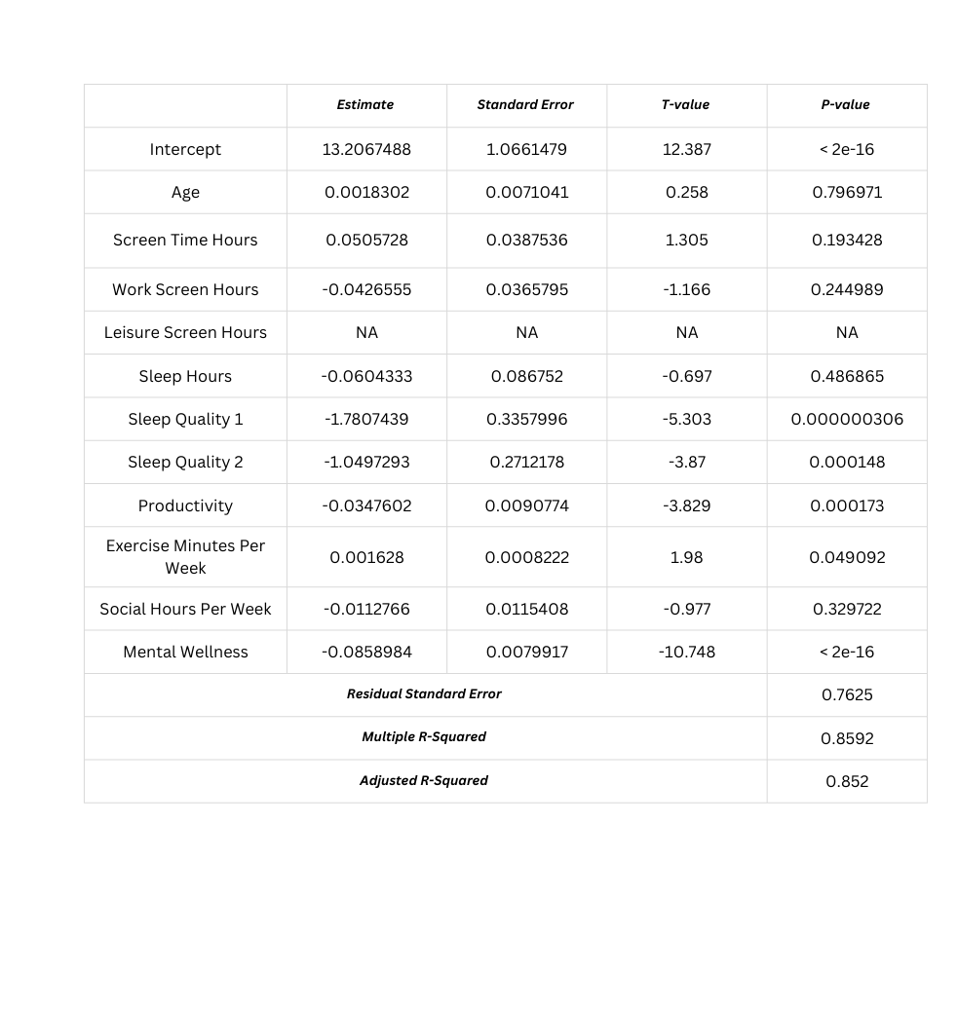
Group 5 LA06
Ordinary Least Square (OLS)
At the exploratory stage, all independent variables were included in a multiple linear regression model to explain stress level.
The initial model achieved R² = 85.92%, indicating strong explanatory power.
However, to avoid model complexity and improve interpretability, backward elimination was applied for variable selection.

Slide 7
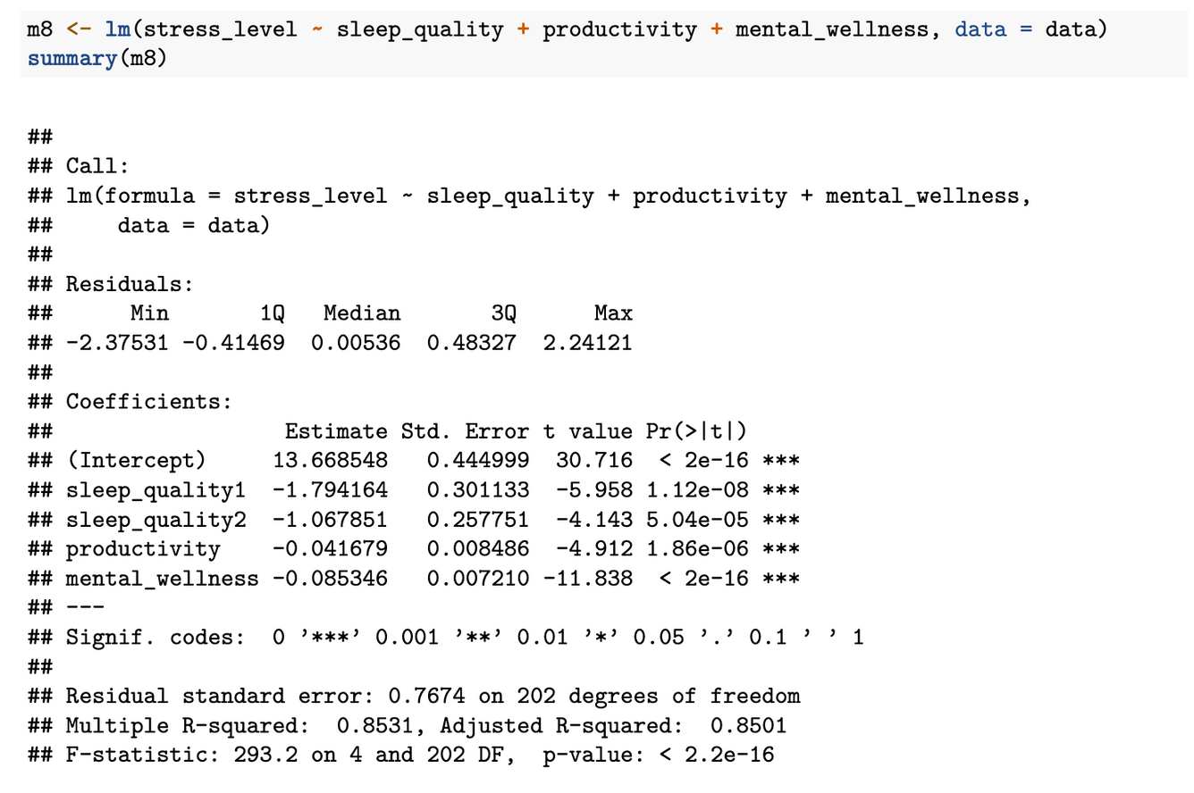
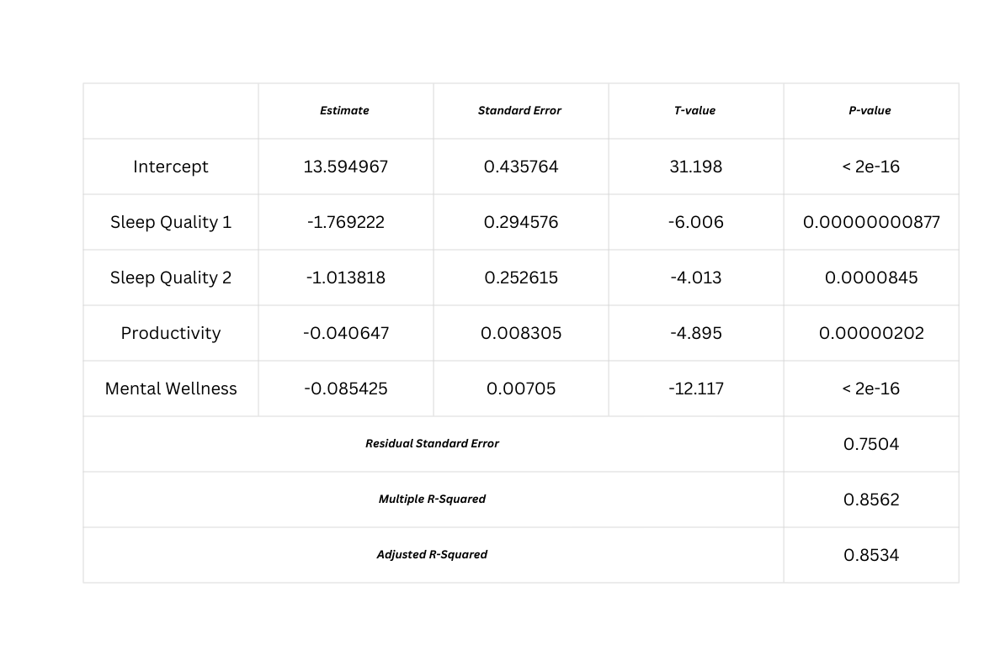
Group 5 LA06
Final OLS Model After Backward Selection
The variable selection process resulted in a final model consisting of three key predictors, namely sleep quality, productivity, and mental wellness. The reduced model achieved a coefficient of determination of R² = 85.62%. Although this value is slightly lower than that of the full model, the difference is relatively small, indicating that the reduced model maintains a high explanatory power while using fewer predictors. Therefore, this reduced model was adopted as the final OLS specification, and these three variables were used in all subsequent analyses and diagnostic tests.
Notes:
Opening & transition dari presenter sebelumnya:
“Continuing from the previous explanation of our full regression model, I will now present the final OLS model after applying backward selection.”
Isi penjelasan slide:
“Based on the backward selection procedure, the final OLS model retains three key predictors: sleep quality, productivity, and mental wellness.”
“These variables were selected because they remain statistically significant and contribute meaningfully to explaining stress levels.”
“The reduced model achieves an R-squared value of 85.62%, which is only slightly lower than the full model. This indicates that the explanatory power remains high despite using fewer predictors.”
“Therefore, this reduced model was adopted as the final OLS specification, and these three variables were used in all subsequent analyses and diagnostic tests.”

Slide 8

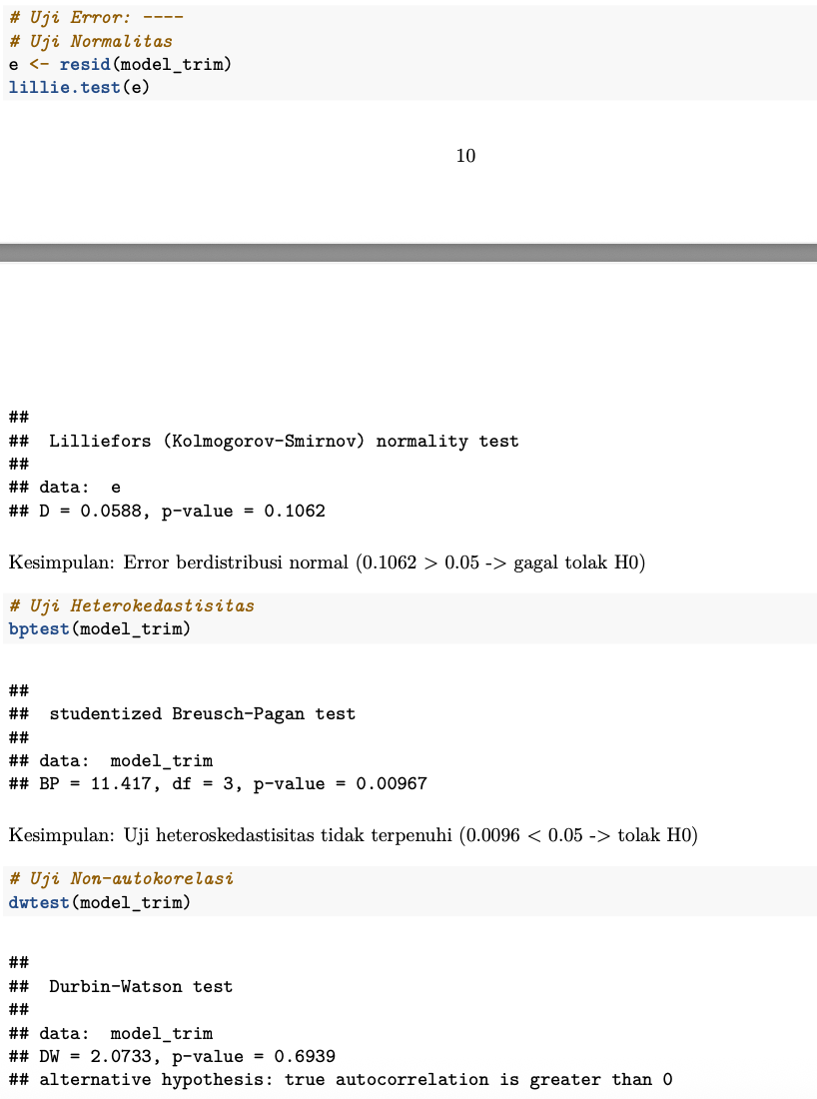
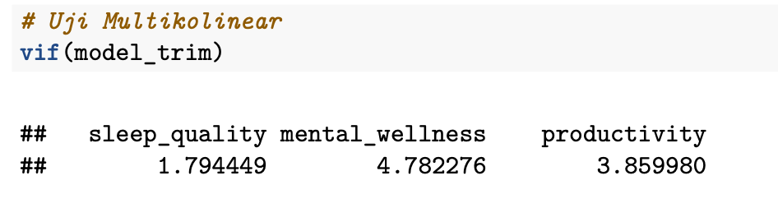
OLS Assumption Diagnostic Tests
Group 5 LA06
Kolmogorov-Smirnov
Breusch-Pagan
p-value = 0.1062 > 0.05,
the residuals are normally distributed.
p-value of 0.009588 < 0.05,
indicating a violation of the homoskedasticity assumption.
Durbin-Watson
VIF Test
p-value = 0.6939,
no evidence of autocorrelation
No multicollinearity is detected, as all Variance Inflation Factor (VIF) values fall below the critical threshold (VIF < 10).
Notes:
“After establishing the final OLS model, we conducted several diagnostic tests to evaluate whether the classical OLS assumptions were satisfied.”
“First, the Kolmogorov–Smirnov test shows a p-value greater than 0.05, indicating that the residuals are normally distributed.”
“Second, the Durbin–Watson test yields a p-value of 0.6939, suggesting that there is no evidence of autocorrelation in the residuals.”
“Third, the Variance Inflation Factor values for all predictors are below 10, which means there is no multicollinearity problem.”
“However, the Breusch–Pagan test produces a p-value below 0.05, indicating a violation of the homoskedasticity assumption.”
“Because heteroskedasticity is present, the OLS estimates may be inefficient, which motivates the use of an alternative estimation method.”

Slide 9
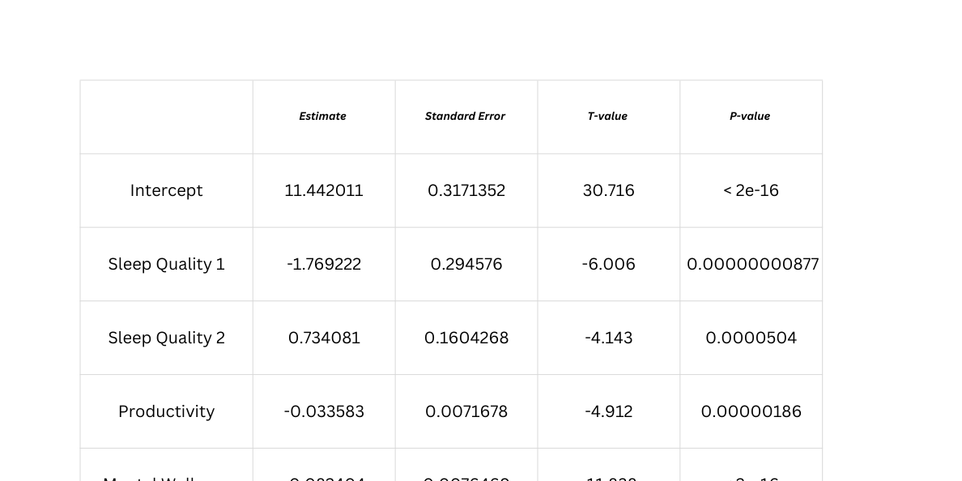
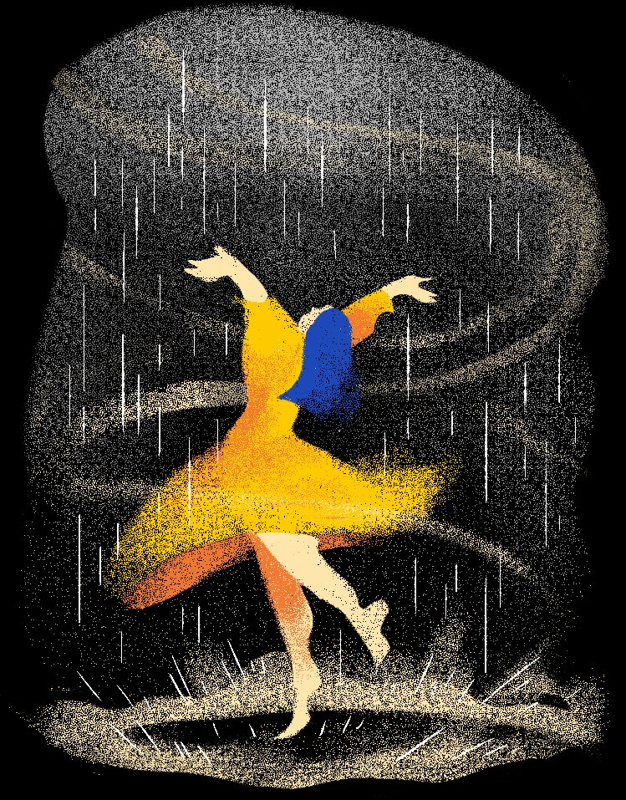
Group 5 LA06
Generalized Least Squares (GLS)
  To address heteroskedasticity in the OLS model, the regression was re-estimated using Generalized Least Squares (GLS) with a power variance function.
  Productivity and mental wellness show negative effects on stress levels, while sleep quality remains a significant predictor.
  Diagnostic tests confirm a substantial reduction in heteroskedasticity.
  All predictors remain statistically significant, with coefficient signs consistent with the OLS results.
The GLS model is therefore adopted as the preferred and final specification for explaining stress levels.
Notes:
“To address the heteroskedasticity issue identified in the OLS model, we re-estimated the regression using the Generalized Least Squares, or GLS, approach.”
“The GLS results show that productivity and mental wellness continue to have negative and statistically significant effects on stress levels, while sleep quality remains an important predictor.”
“Importantly, the coefficient signs and significance levels are consistent with the OLS results, indicating robustness of the findings.”
“Diagnostic tests confirm a substantial reduction in heteroskedasticity, making the GLS estimates more efficient and reliable.”
“Therefore, the GLS model is adopted as the preferred and final specification for explaining stress levels.”
Kalimat penutup & handoff ke Tasya:
“That concludes my part of the presentation. I will now hand over the next section to my teammate.”

Slide 10
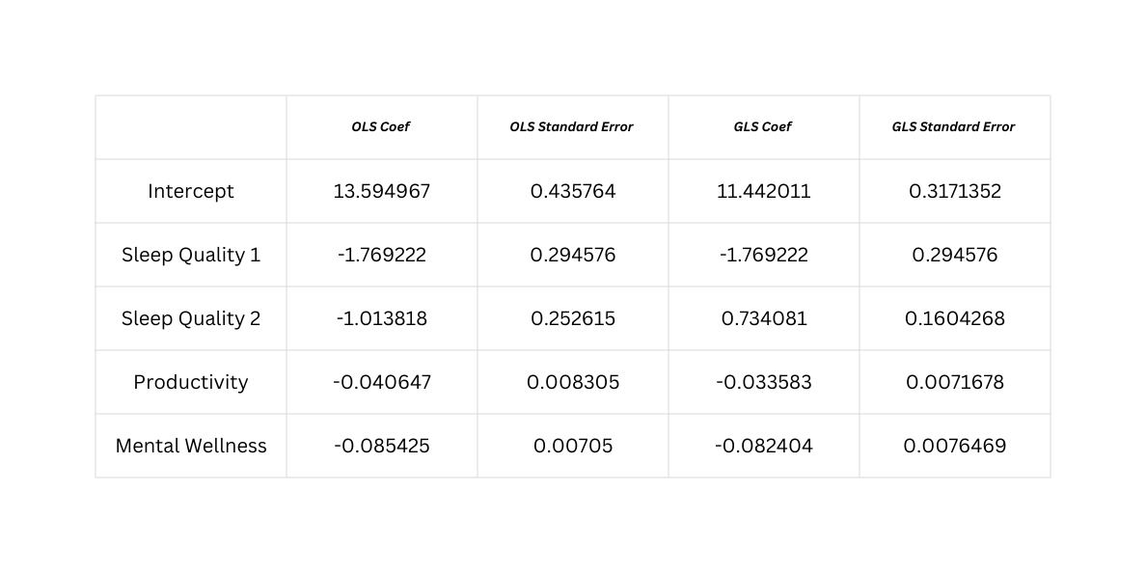
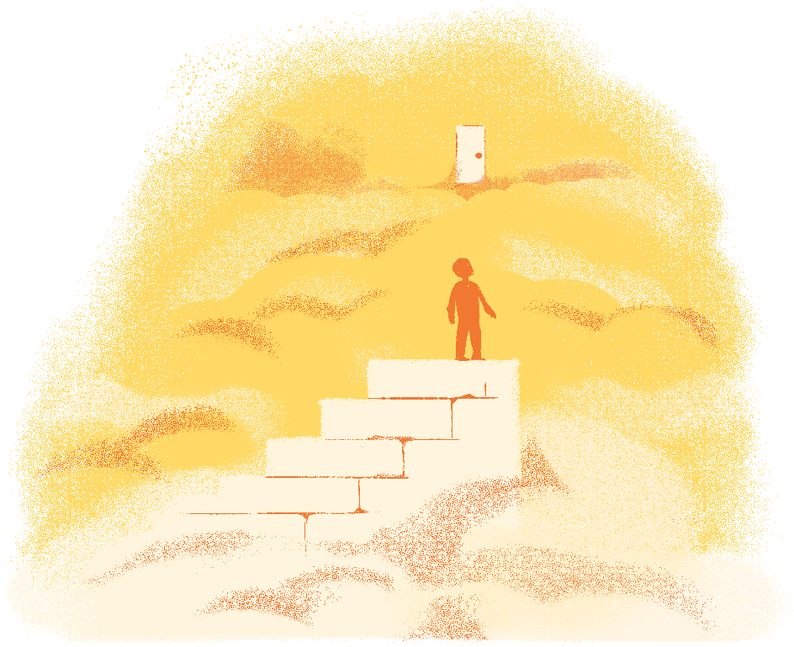

Group 5 LA06
OLS vs GLS
Coefficient signs and magnitudes are largely consistent across OLS and GLS, indicating stable relationships between stress level and its predictors.
All key predictors remain statistically significant, confirming the robustness of the results.
The GLS model produces smaller standard errors for all retained variables, reflecting improved estimation efficiency after accounting for heteroskedasticity.

Slide 11

Group 5 LA06
Conclusion
This study analyzes the effects of sleep quality, productivity, and mental wellness on stress levels among employed and self-employed individuals. The results show that all three variables significantly influence stress, with mental wellness having the strongest impact, followed by sleep quality and productivity. The OLS model violates the homoscedasticity assumption, leading to inefficient estimates, while the GLS approach corrects this issue and provides more efficient and reliable parameter estimates. Therefore, GLS is considered the preferred method for analyzing stress-related data in the presence of heteroskedasticity.

Slide 12
Group 5 LA06
Link Explanation Video
https://drive.google.com/file/d/1xoZnNJ4jH7Ubftn0Pghi_bOro5qM-Y88/view?usp=sharing

Slide 13



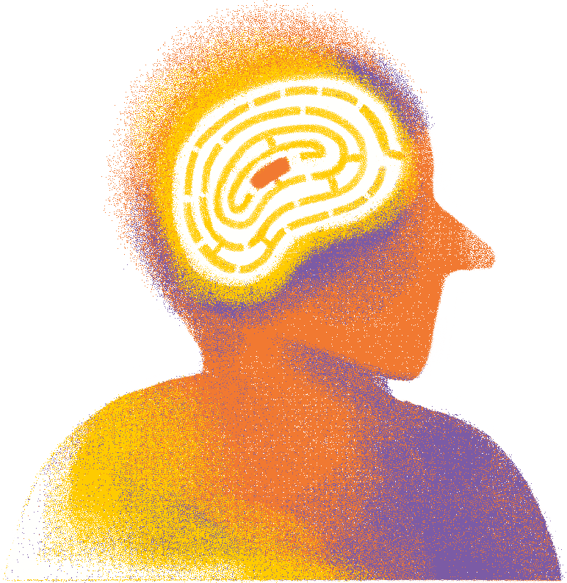
Thank You

